Slide 1
Web services
-Services available over the web
-enables communication b/w application over the web
-provides a standard protocol/format for communication
Why we use it?
-platform independent communication
-using web services two different application(implementation) can talk to each other and exchange data/information

Slide 2
A Web service provider develops/implements the application (web service)
And makes it available over the internet
Web services
Client
Service consumer
request
Server
Service provider
response
MEDIUM –HTTP/INTERNET
FORMATE-XML/JSON

Slide 3
SOAP-
Simple Object Access Protocol
Medium :HTTP(POST)
Format: XML

Slide 4
REST
Representational State Transfer
Medium :HTTP(POST,GET,PUT,DELETE..)
Format :XML/JSON/TEXT..

Slide 5
WSDL
Web Services Description Language-XML based interface
Service provider publishes an interface for his web services that describes all attributes of the web services.
It describes the functionalities of the web services

Slide 6
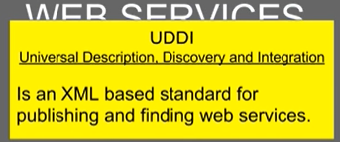
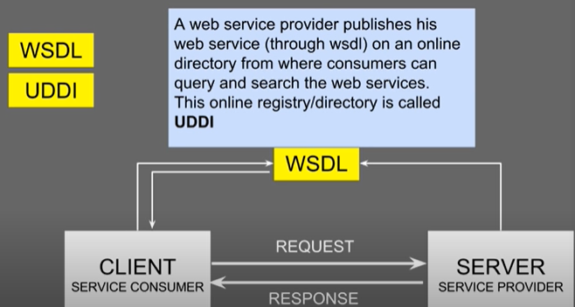
UDDI

Slide 7
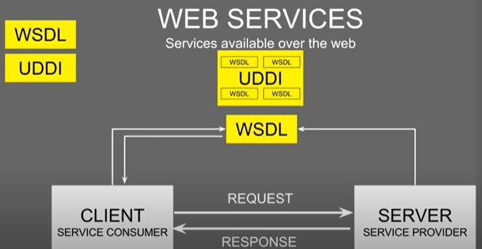

Slide 8
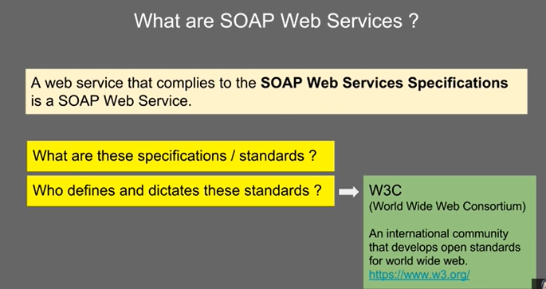

Slide 9
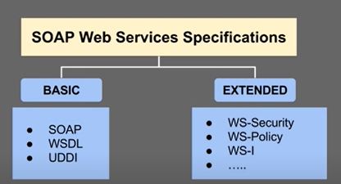
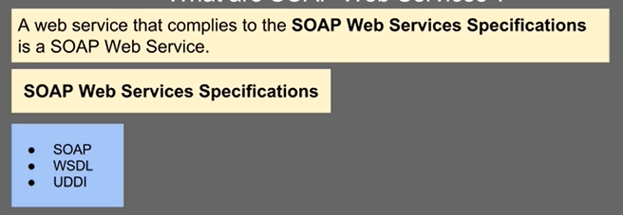

Slide 10
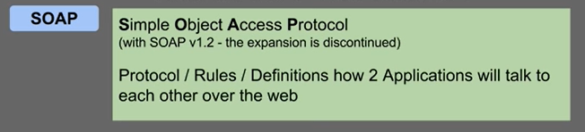

SOAP

Slide 11
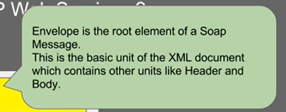
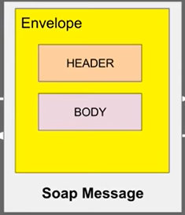
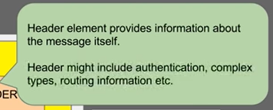


Slide 12
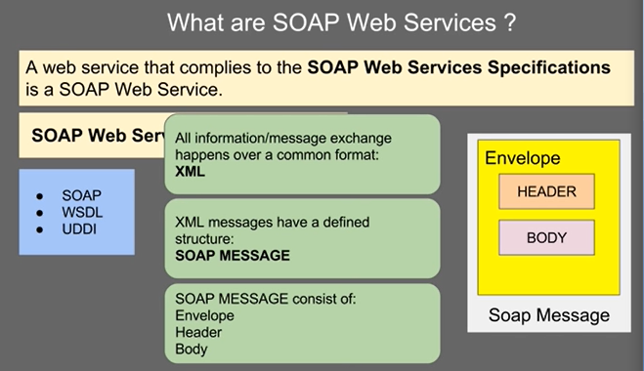

Slide 13
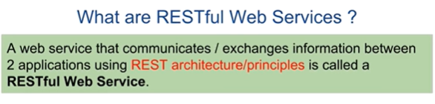
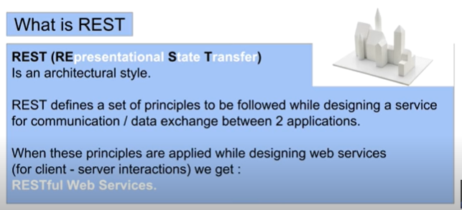
REST

Slide 14
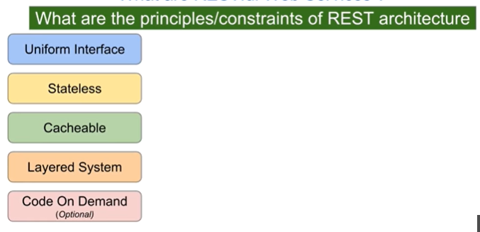
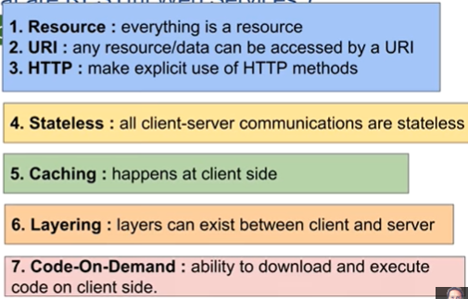

Slide 15
